Slide 1
Machine-Learning Techniques for Predictive Analytics
Notes:
If this PowerPoint presentation contains mathematical equations, you may need to check that your computer has the following installed:
1) Math Type Plugin
2) Math Player (free versions available)
3) NVDA Reader (free versions available)

Slide 2
Learning Objectives
Understand the basic concepts and definitions of artificial neural networks (ANN)
Learn the different types of ANN architectures
Understand the concept and structure of support vector machines (SVM)
Learn the advantages and disadvantages of SVM compared to ANN
Understand the concept and formulation of k-nearest neighbor (kNN) algorithm
Learn the advantages and disadvantages of kNN compared to ANN and SVM
Understand the basic principles of Bayesian learning and Naïve Bayes algorithm
Notes:
Slide 2 is list of textbook LO numbers and statements

Slide 3
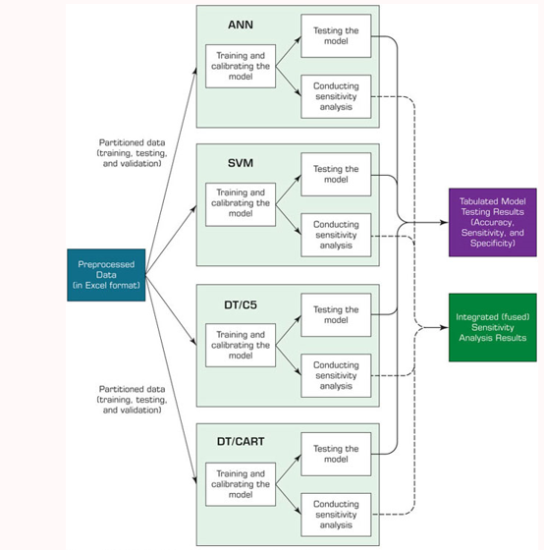
Process Map – Training & Testing Models
Predictive Models

Slide 4
Neural Network Concepts
Neural networks (N N): a human brain metaphor for information processing
Neural computing
Artificial neural network (A N N)
Many uses for A N N
Pattern recognition
Forecasting
Prediction
Classification

Slide 5
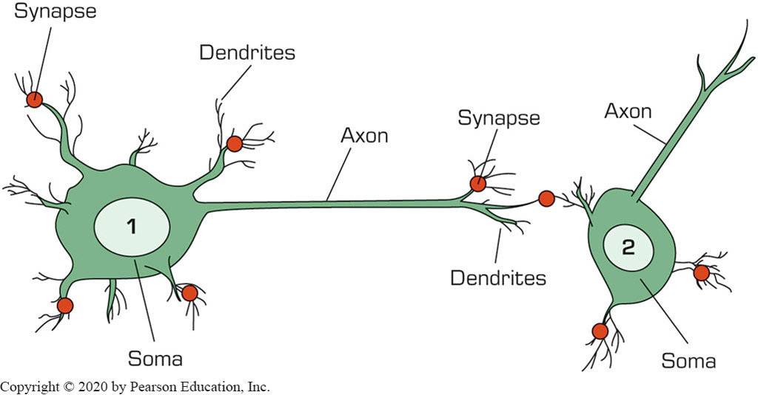
Biological Neural Networks
Two interconnected brain cells (neurons)

Slide 6
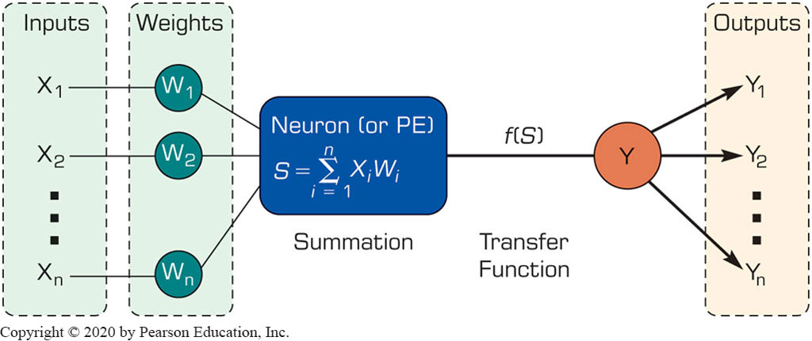
Processing Information in A N N
A single neuron (processing element – P E) with inputs and outputs

Slide 7
Biology Analogy
Biological
Artificial
Soma
Dendrites
Axon
Synapse
Slow
Many neurons
Node
Input
Output
Weight
Fast
Few neurons (dozen to hundreds of thousands)

Slide 8
Elements of A N N
Processing element (P E)
Network architecture
Hidden layers
Parallel processing
Network information processing
Inputs
Outputs
Connection weights
Summation function

Slide 9
Neural Network Architectures
Architecture of a neural network is driven by the task it is intended to address
Classification
Regression
Clustering
General optimization
Association
Feed forward, multi-layered perceptron with back propagation learning algorithm
Most popular architecture:
Other A N N Architectures
Recurrent
Self-organizing feature maps
Hopfield networks

Slide 10
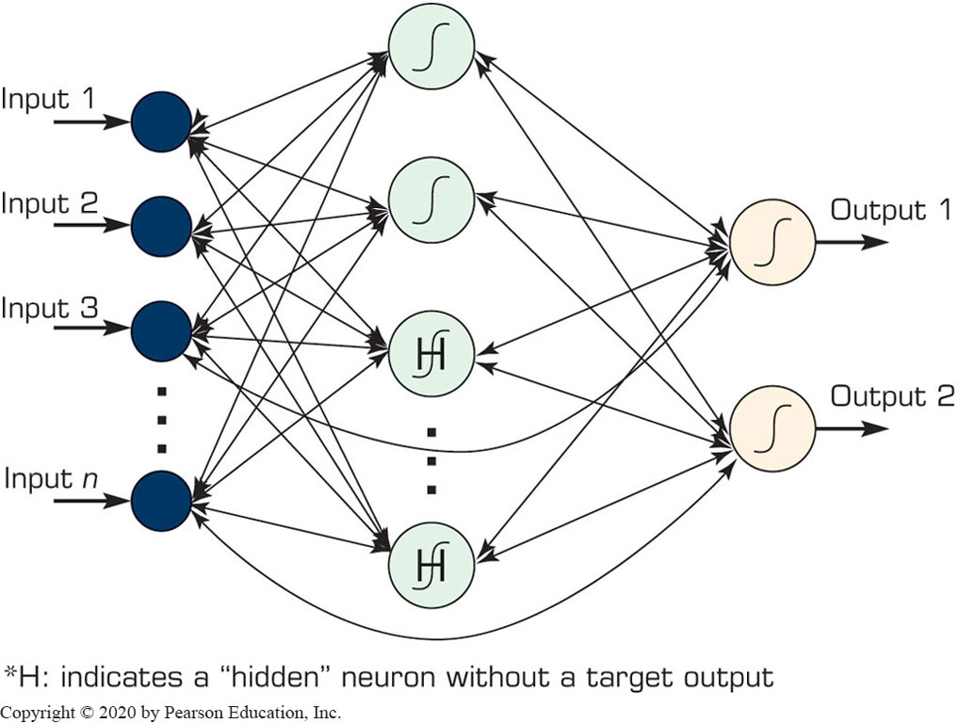
Neural Network Architectures Recurrent Neural Networks

Slide 11
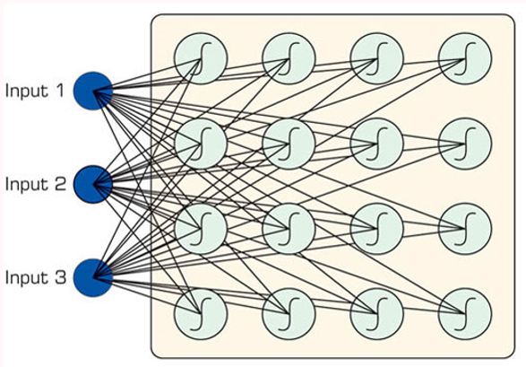
Neural Network Architectures Self Organizing Maps (S O M)
First introduced by the Finnish Professor Teuvo Kohonen
Applies to clustering type problems

Slide 12
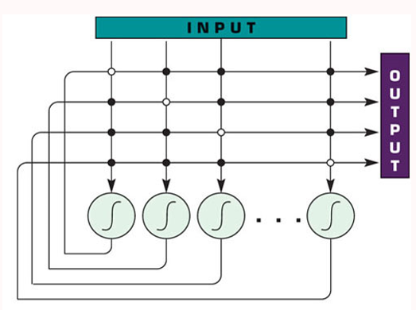
Other Popular A N N Paradigms Hopfield Networks
First introduced by John Hopfield
Highly interconnected neurons
Applies to solving complex computational problems (e.g., optimization problems)

Slide 13
Support Vector Machines (S V M)
SVM are among the most popular machine-learning techniques.
SVM belong to the family of generalized linear models – capable of representing non-linear relationships in a linear fashion
SVM achieves a classification or regression decision based on the value of the linear combination of input features.
Because of their architectural similarities, SVM are also closely associated with ANN.

Slide 14
Support Vector Machines (S V M)
Goal of SVM:
generate mathematical functions that map input variables to desired outputs for classification or regression type prediction problems.
How:
First, SVM uses nonlinear kernel functions to transform non-linear relationships among the variables into linearly separable feature spaces.
Then, the maximum-margin hyperplanes are constructed to optimally separate different classes from each other based on the training dataset.
SVM has solid mathematical foundation!

Slide 15
Support Vector Machines (S V M)
Hyperplane – geometric concept used to describe the separation surface between different classes of things.
In SVM, two parallel hyperplanes are constructed on each side of the separation space with the aim of maximizing the distance between them.
A kernel function in SVM uses the kernel trick (a method for using a linear classifier algorithm to solve a nonlinear problem)
The most commonly used kernel function is the radial basis function (RBF).
Most widely used kernel-learning algorithms for wide range of classification and regression problems
Represents state-of-the-art by virtue of their excellent generalization performance, superior prediction power, ease of use, and rigorous theoretical foundation
Most comparative studies show its superiority in both regression and classification type prediction problems.

Slide 16
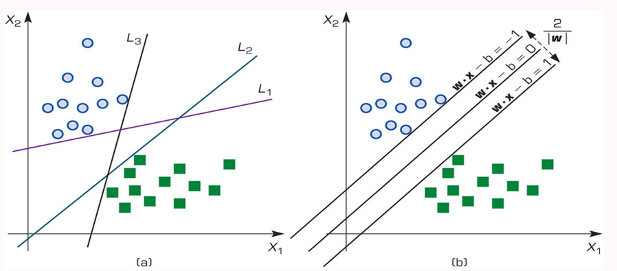
Support Vector Machines (S V M)
Many linear classifiers (hyperplanes) may separate the data

Slide 17
How Does S V M Work?
Following a machine-learning process, a SVM learns from the historic cases.
The Process of Building SVM
Preprocess the data
Scrub and transform the data.
2. Develop the model.
Select the kernel type (R B F is often a natural choice).
Determine the kernel parameters for the selected kernel type.
If the results are satisfactory, finalize the model, otherwise change the kernel type and/or kernel parameters to achieve the desired accuracy level.
3. Extract and deploy the model.

Slide 18
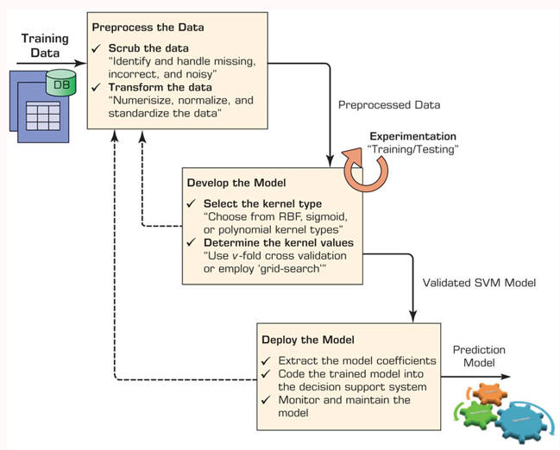
The Process of Building a S V M

Slide 19
k-Nearest Neighbor Method (k-N N)
ANN and SVM → time-demanding, computationally intensive iterative derivations
k-NN a simplistic and logical prediction method, that produces very competitive results
k-NN is a prediction method for classification as well as regression types (similar to ANN & SVM)
k-NN is a type of instance-based learning (or lazy learning) – most of the work takes place at the time of prediction (not at modeling)
k : the number of neighbors used in the model

Slide 20
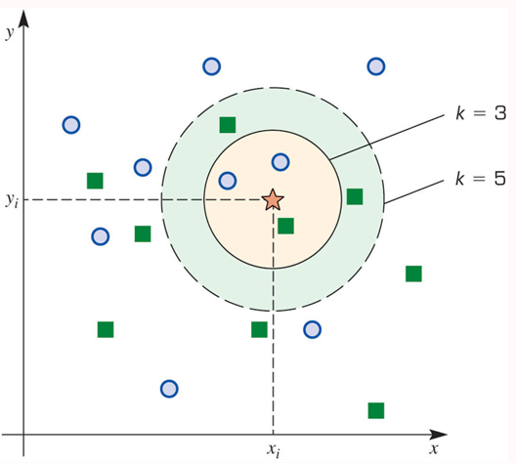
k-Nearest Neighbor Method (k-N N)
The answer to “which class a data point belongs to?” depends on the value of k

Slide 21
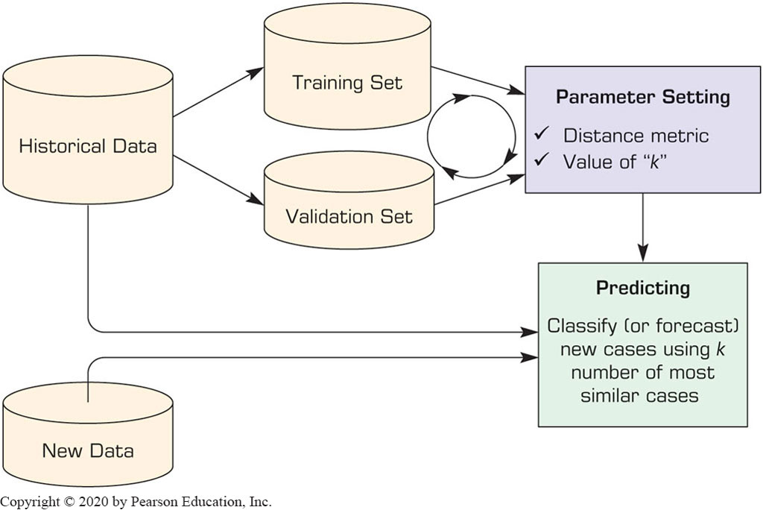
The Process of k-N N Method

Slide 22
k-N N Model Parameter
Similarity Measure: The Distance Metric
Consider numeric versus nominal values

Slide 23
k-N N Model Parameter
Number of Neighbors (the value of k)
The best value depends on the data
Larger values reduces the effect of noise but also make boundaries between classes less distinct
An “optimal” value can be found heuristically
Cross Validation – often used to determine the best value for k and the distance measure

Slide 24
Naïve Bayes Method for Classification
Naïve Bayes is a simple probability-based classification method
Naïve - assumption of independence among the input variables
Can use both numeric and nominal input variables
Numeric variables need to be discretized
Can be used for both regression and classification
Naïve based models can be developed very efficiently and effectively
Using maximum likelihood method

Slide 25
Bayes Theorem
Developed by Thomas Bayes (1701–1761)
Determines the conditional probabilities
Given that X and Y are two events:

Slide 26
Naïve Bayes Method for Classification
Process of Developing a Naïve Bayes Classifier
Training Phase
Obtain and pre-process the data
Discretize the numeric variables
Calculate the prior probabilities of all class labels
Calculate the likelihood for all predictor variables/values
Testing Phase
Using the outputs of Steps 3 and 4 above, classify the new samples

Slide 27
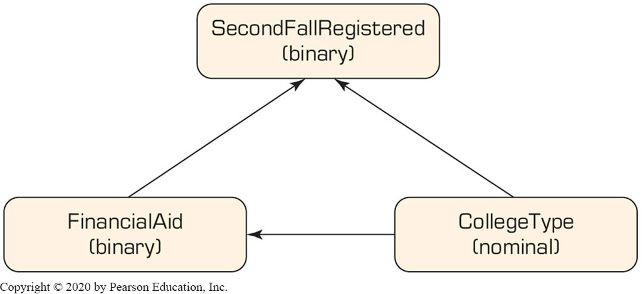
Bayesian Networks
A tool for representing dependency structure in a graphical, explicit, and intuitive way
A directed acyclic graph whose nodes correspond to the variables and arcs that signify conditional dependencies between variables and their possible values
Direction of the arc matter
A partial causality link in student retention

